Slide 1
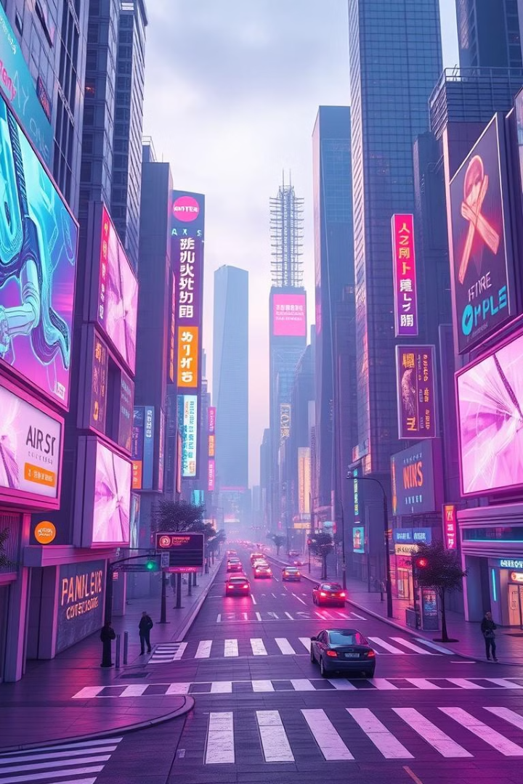
AI-Generated Images: A Deep Dive
Explore the exciting world of AI image generation. Learn about popular platforms and how they work.
Darmohrai Anastasiia 501 group

Slide 2
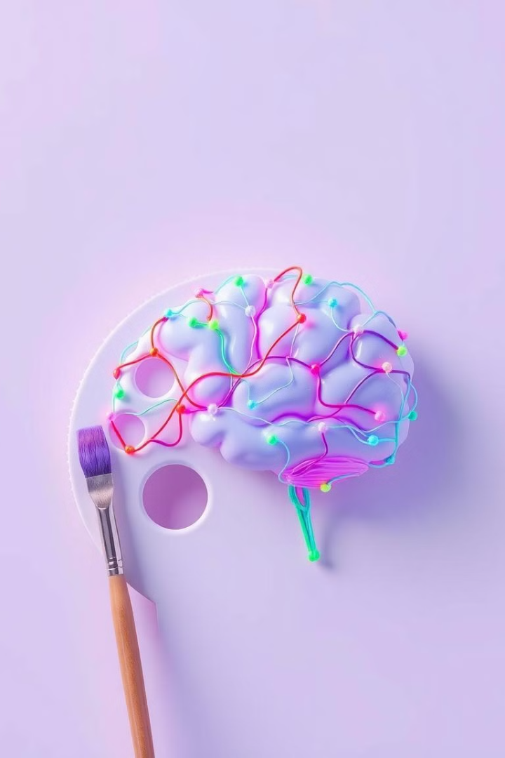
What is AI Image Generation?
AI image generation uses artificial intelligence to create images. It interprets text or visual input. This allows for creating original, realistic, or stylized images.
It democratizes content creation. Anyone can make stunning visuals with simple prompts.
1
Accessibility
2
Efficiency
No need for advanced skills.
Rapid content creation.
3
Innovation
Explore new creative avenues.

Slide 3
Top AI Image Platforms
You can look to these AI image generators for inspiration and brainstorming, and you can create personalized art. You don't have to be an artist or have extensive design skills to bring your creative visions to life. But not all AI image generators are going to be right for you and your project. Picking the right AI service can feel overwhelming because there are a lot of options available.
Midjourney
DALL-3
Stable Diffusion
Best for artistic styles and aesthetics.
Excels at prompt understanding.
Offers great customization.
Canva
Adobe Firefly
Craiyon
User-friendly and best for beginners.
For more experiments and professionals.
Alternative version of DALL·E mini, by the same developers.

Slide 4
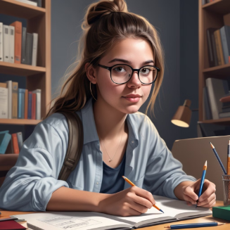
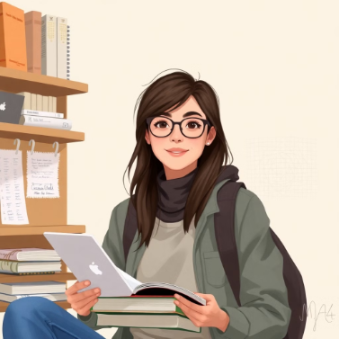
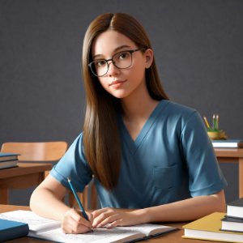
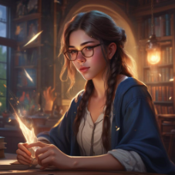
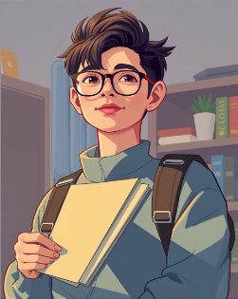
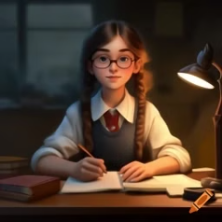
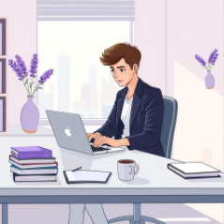
Some results
Promt: Create a realistic digital illustration of a young student in their early 20s, balancing work and study while pursuing a master's degree.

Slide 5
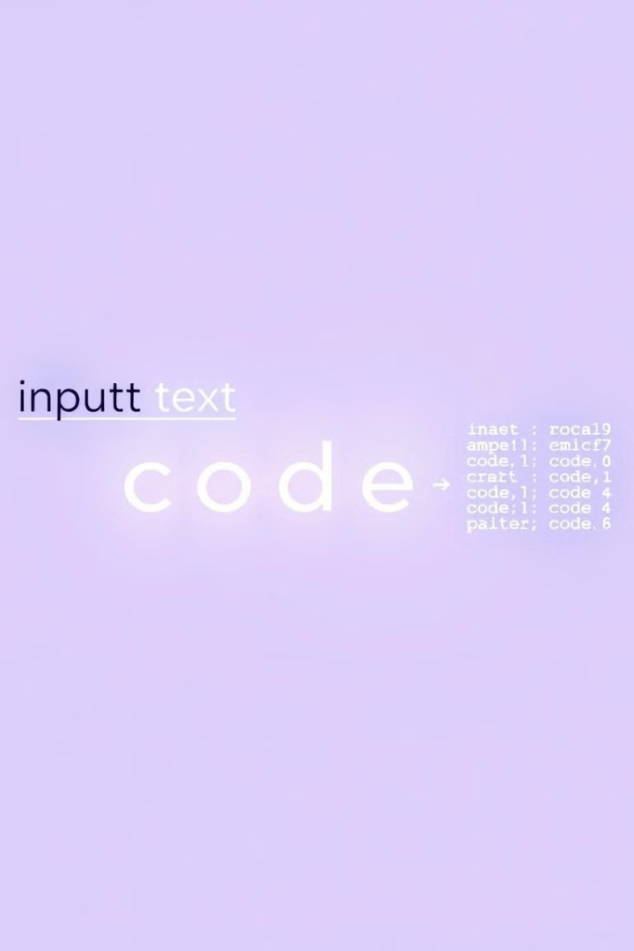
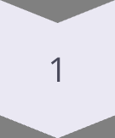
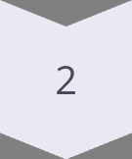
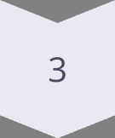
How AI Image Generation Works
AI image generation relies on deep learning models. Generative Adversarial Networks (GANs) are commonly used.
These models learn from vast datasets of images. They can then create new images from input text or images.
Data Input
Vast image datasets.
Deep Learning
GANs learn image features.
Image Synthesis
Generate new images.

Slide 6
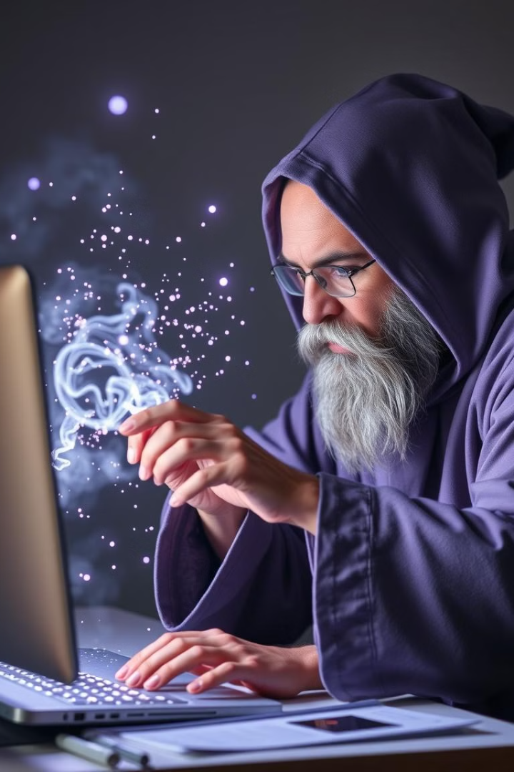
Prompt Engineering
Prompt engineering is essential for quality AI images. Crafting precise and creative text prompts is key.
Experiment with descriptive language and artistic styles. Add details about mood and lighting to enhance results.
Specificity
Creativity
Use precise language.
Experiment with styles.
Details
Specify mood and lighting.

Slide 7
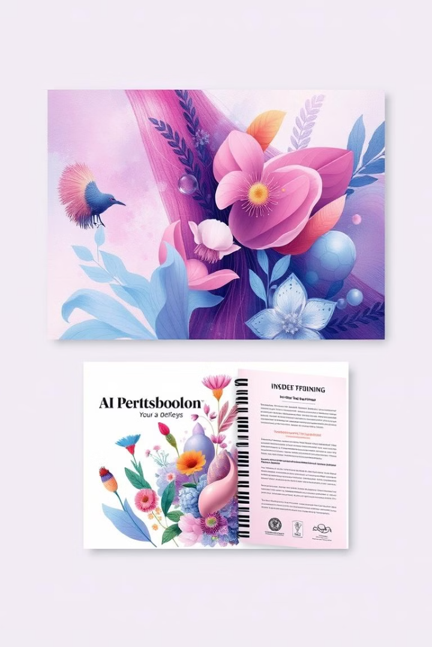






Use Cases
AI image generation has diverse applications. It revolutionizes art, design, marketing, and education.
It accelerates content creation and enables innovative solutions. It also provides custom visuals for various needs.
Art & Design
Marketing
Education
Create digital art.
Generate ad content.
Illustrate learning materials.
Branding
Product Development
Personal Use & Social Media
Develop unique logos, icons, and etc
Concept designs, 3D models, product mockups
AI generates unique digital avatars

Slide 8
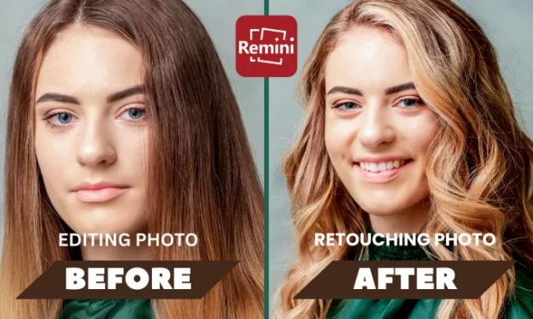
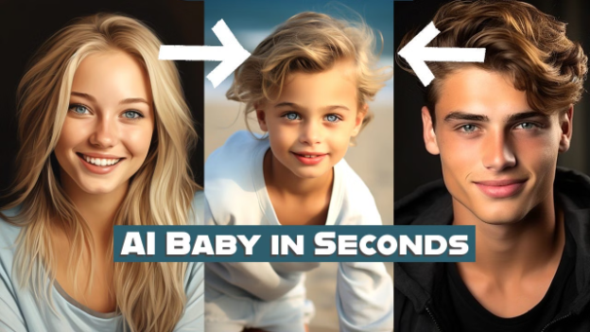
AI in Social media:
Popular AI Photo Editing Apps:
📌 Remini – Enhances low-quality images and generates realistic AI headshots.
📌 Adobe Photoshop AI Tools – Uses AI to automate complex edits.
📌 FaceApp – Modifies facial expressions, age, and other features.
📌 Canva AI Editor – Offers AI-powered retouching and background removal.
The fascination with AI baby generators reflects a broader trend of individuals exploring AI's capabilities to envision personal and future scenarios.
As technology continues to advance, these applications are expected to become even more sophisticated, offering increasingly accurate and personalized predictions.

Slide 9
My experiments with Remini:
Key Features:
AI Photo Generation: Users can create realistic AI-generated photos by uploading 8 to 12 selfies. The app then processes these images to produce high-quality headshots suitable for professional profiles or social media. REMINI.ZENDESK.COM
AI Avatars: Remini allows users to generate creative AI avatars by uploading high-quality pictures. This feature is popular among those looking to refresh their social media profile pictures with unique, AI-crafted images. MARIPATXI.COM
Photo Restoration: The app enhances old or low-quality photos by adding detail, improving face quality, and adjusting colors and tones, effectively bringing new life to cherished memories.
AI Baby Generator: A fun addition to Remini's feature set, this tool uses advanced AI algorithms to predict the appearance of potential future children by analyzing photos of prospective parents.

Slide 10

Ethical Considerations
AI image generation raises ethical concerns. Copyright infringement is a key issue. AI can perpetuate biases in data.
Deepfakes and misinformation are potential risks. Transparency and responsible use are essential.
Copyright
1
Ownership of generated images.
2
Bias
Reflecting societal biases.
Deepfakes
3
Potential for misuse.

Slide 11
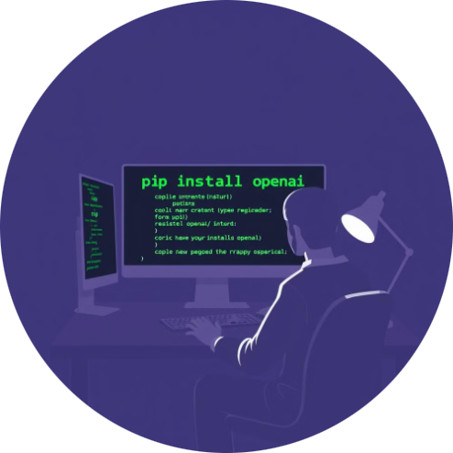
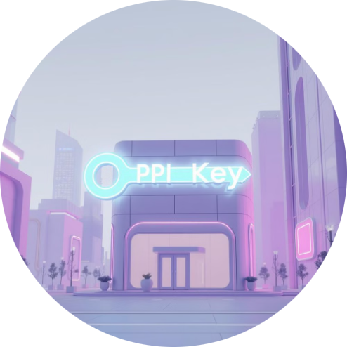

Generate images by yourself
Installation
Get Your OpenAI API Key
Use it
First, install openai
Go to OpenAI and create an account.
Utilize Jupyter Notebook or an alternative tool to write well-structured and clear Python code
Use Command: pip install openai
Get an API key from the OpenAI dashboard.

Slide 12
Which model should I use?
Model
Sizes options (pixels)
Quality options
Requests you can make
256x256
Only standard
Up to 10 images at a time, with the n parameter
DALL·E 2
512x512
1024x1024
Model
Sizes options (pixels)
Quality options
Requests you can make
1024x1024
Defaults to standard
Only 1 at a time, but can request more by making parallel requests
DALL·E 3
1024x1792
Set quality: "hd" for enhanced detail
1792x1024
The image generations endpoint allows you to create an original image with a text prompt. Each image can be returned either as a URL or Base64 data, using the response_format parameter. The default output is URL, and each URL expires after an hour.

Slide 13
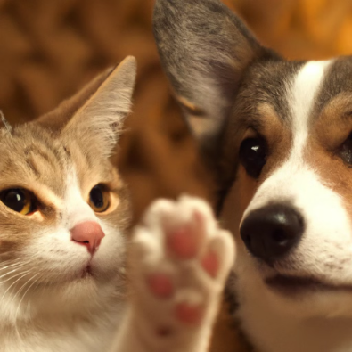
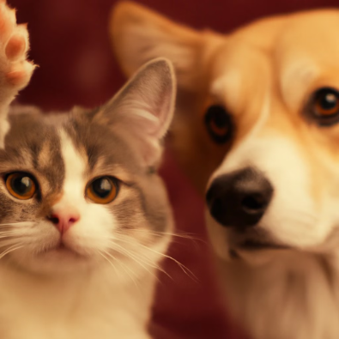
Expamples:
from openai import OpenAI
client = OpenAI(api_key=client)
response = client.images.create_variation(
model="dall-e-2",
image=open("corgi_and_cat_paw.png", "rb"),
n=1,
size="1024x1024"
)
print(response.data[0].url)
Image
Output

Slide 14
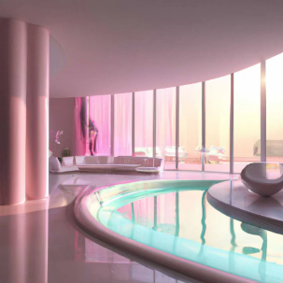
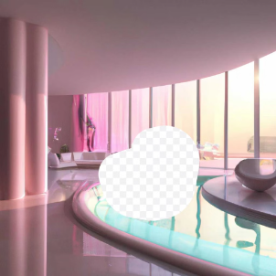
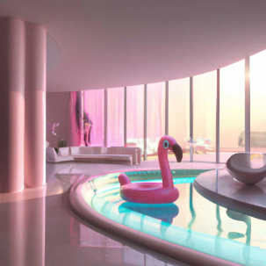
Edits (DALL·E 2 only)
The image edits endpoint lets you edit or extend an image by uploading an image and mask indicating which areas should be replaced. This process is also known as inpainting.
The transparent areas of the mask indicate where the image should be edited, and the prompt should describe the full new image, not just the erased area. This endpoint enables experiences like DALL·E image editing in ChatGPT Plus.
from openai import OpenAI
client = OpenAI()
response = client.images.edit(
model="dall-e-2",
image=open("sunlit_lounge.png", "rb"),
mask=open("mask.png", "rb"),
prompt="A sunlit indoor lounge area with a pool containing a flamingo",
n=1,
size="1024x1024",
)
print(response.data[0].url)
Image
Mask
Output

Slide 15



The Future of AI Image Generation
AI image generation continues to evolve rapidly. Expect more sophisticated models and enhanced realism.
Integration with other technologies will expand use cases. Ethical guidelines and regulations will become more important.
2
Broader Integration
1
Enhanced Realism
Ethical Guidelines
3

Slide 16
Practical Tips
Start with clear and specific prompts. Experiment with different platforms and styles.
Iterate on your prompts based on the results. Combine AI with traditional editing tools for best results.
1
Clear Prompts
2
Experiment
3
Iterate

Slide 17
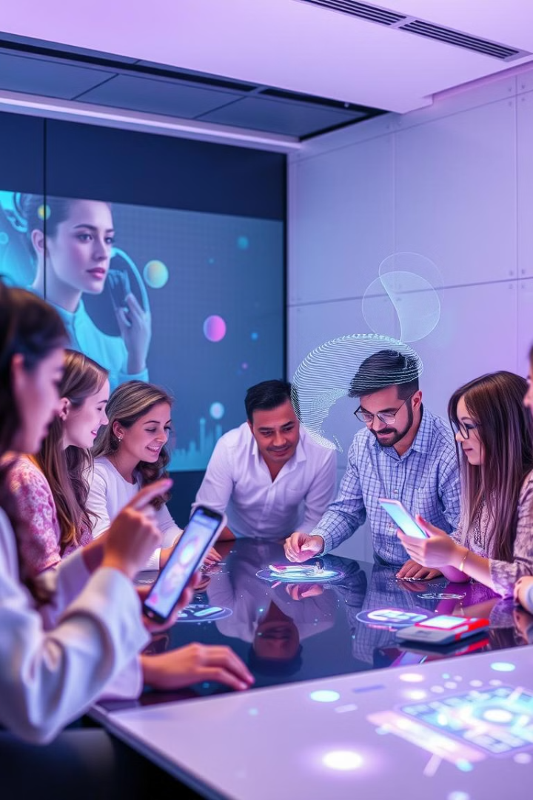
Q&A and Conclusion
AI image generation unleashes creative potential. It empowers users to create stunning visuals. It can be used by artists, designers, and educators.
Embrace AI image generation as a creative tool. Experiment to create impactful visuals.

